Slide 1
Elementary sorts

Slide 2
Selection sort
public class MySelectionSort {
public static int[] doSelectionSort(int[] arr){
for (int i = 0; i < arr.length - 1; i++)
{
int index = i;
for (int j = i + 1; j < arr.length; j++)
if (arr[j] < arr[index])
index = j;
int smallerNumber = arr[index];
arr[index] = arr[i];
arr[i] = smallerNumber;
}
return arr;
}
-http://www.java2novice.com/java-sorting-algorithms/selection-sort/

Slide 3
Selection sort complexity
Total items to sort? -> n
Loops?
for (j = 0; j < n-1; j++) { //outer
for ( i = j+1; i < n; i++) { //inner
So outer loop n-1 times?

Slide 4
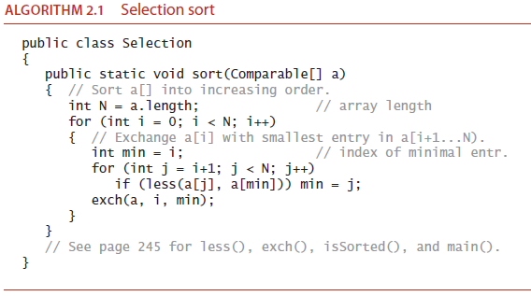

Slide 5
So, whenever inner loop executes n-k items are compared to one another?
Two values are compared to each other so complexity n-k)
So Total
T(n) = (n-1) + (n-2) + … ( n- (n-1))
(sum of 1st n-1 integers) => n (n-1)/2
=O(n^2)

Slide 6
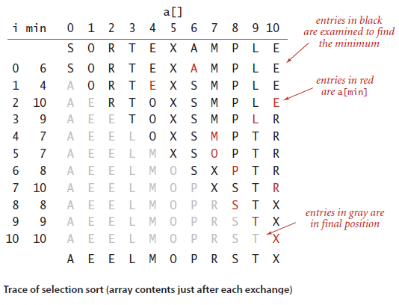
N²/2 compares. N exchanges

Slide 7
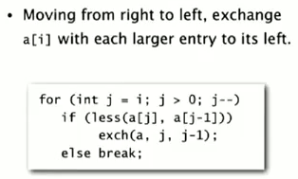
Insertion sort
For i from 0 to n
for j from i to 1
if a[j] > a[j+1] then swap

Slide 8
Insertion Sort
Best Case
N-1 comparisons -> Why?
Worst Case
Compares ½ *n^2
Exchanges ½ *n^2
What effect is the order of entries having?

Slide 9
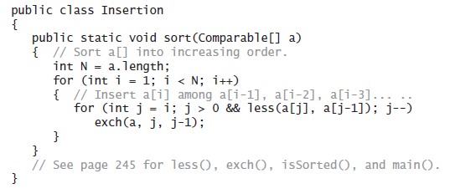

Slide 10
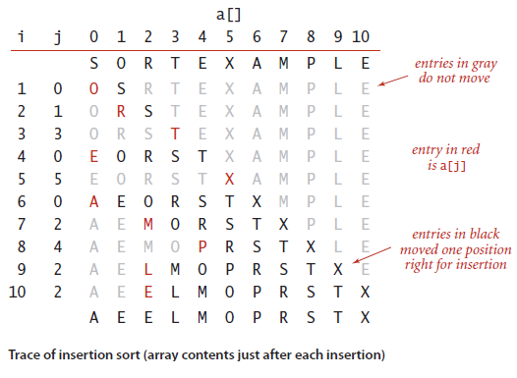
Insertion sort uses N²/4 compares and N²/4 exchanges to sort
a randomly ordered array of length N with distinct keys, on the average. The worst
case is N²/2 compares and N²/2 exchanges

Slide 11
Selection vs Insertion?
No of compares vs Exchanges?

